Slide 1
Boosting Algorithms

Slide 2
Ada Boost
Ada boost regressor model fits the regressor on the dataset
After that the points that are not fit accurately are taken and given high weightage
Again the model tries to fit these points, the process is repeated
Atlast the weighted average is taken from these to get the accurate result

Slide 3
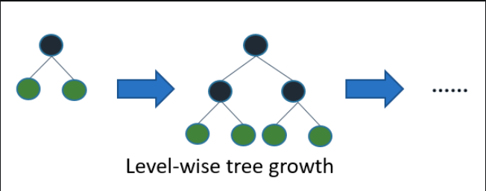
XG boost
XG boost is an implementation of decision trees
Weights are assigned to all independent variables and passed into decision tree
The weights which are predicted wrong are assigned higher weights and again passed to decision trees
The process is repeated until it finds accurate model

Slide 4
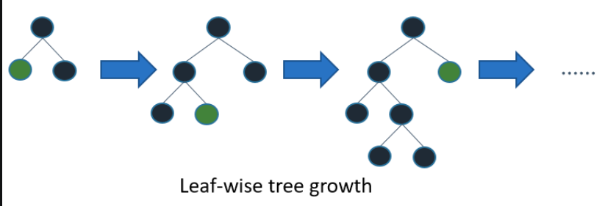
LG Boost
Unlike XG boost , LG boost is leaf wise tree growth and results in higher accuracy
This may result in overfitting the model which is handled using max depth parameters

